Slide 1
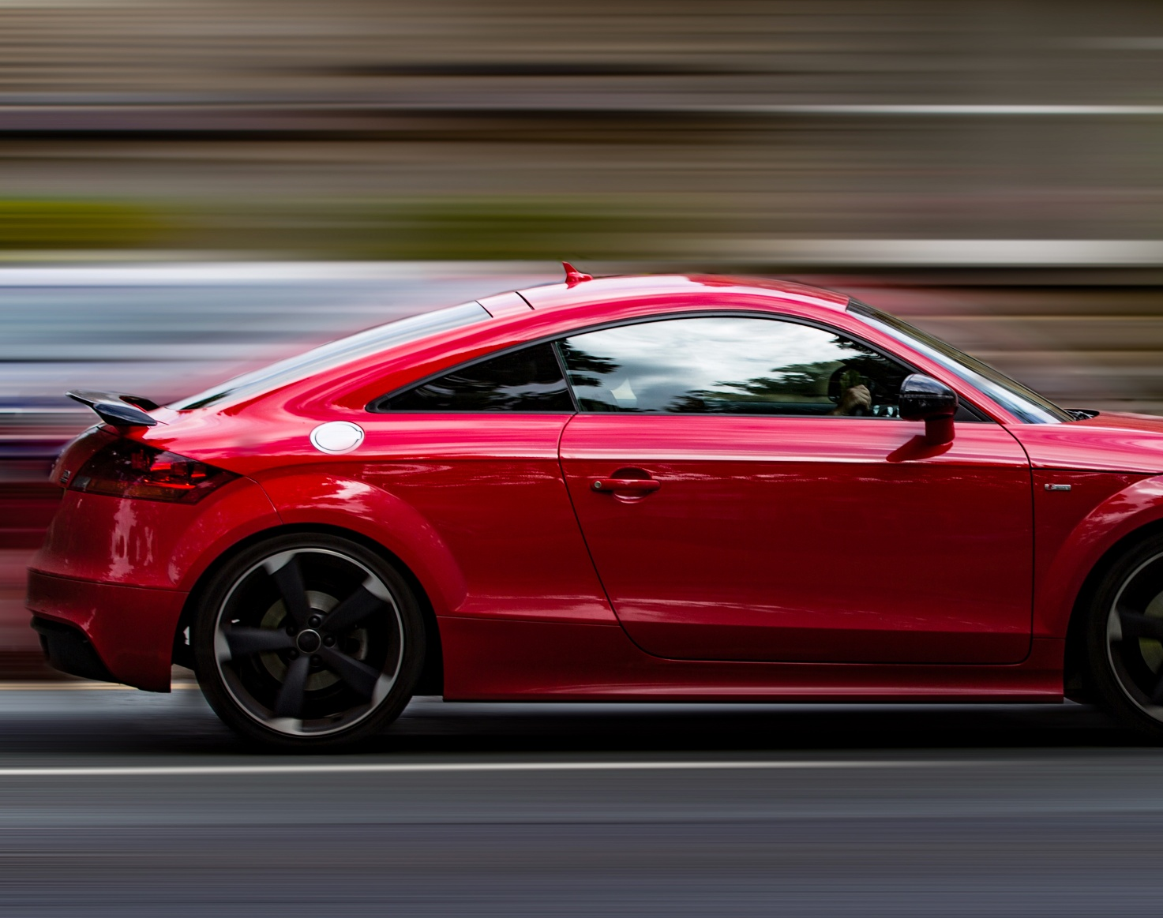
Driving Classification
By: Keegan Henderson

Slide 2
Data Set
Data set revolves around predicting Aggressive driving behavior
6000 rows of data
Variables:
Accelerometer (X,Y,Z)
Gyroscope (X,Y,Z)
Class (Aggressive)
Timestamp (seconds)

Slide 3
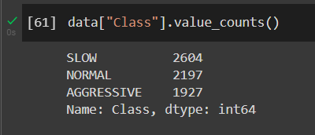
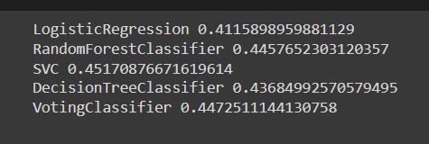
Cleaning
Stratification (no need)
Dropping Columns (Timestamp)
Made results awful
Encoding

Slide 4
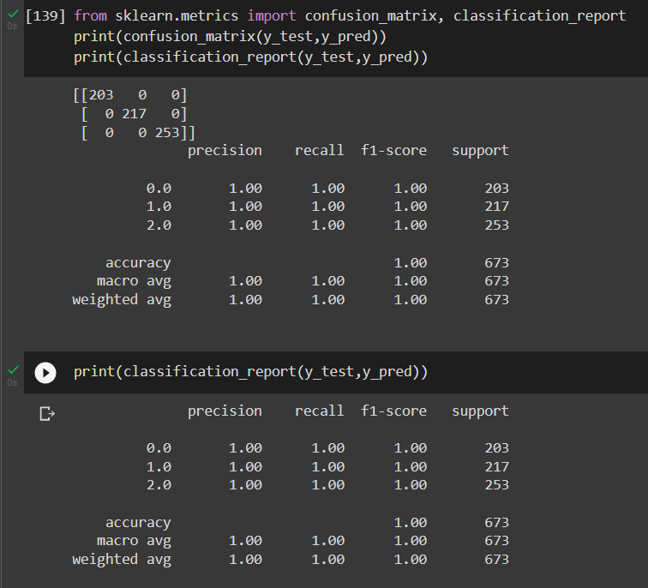

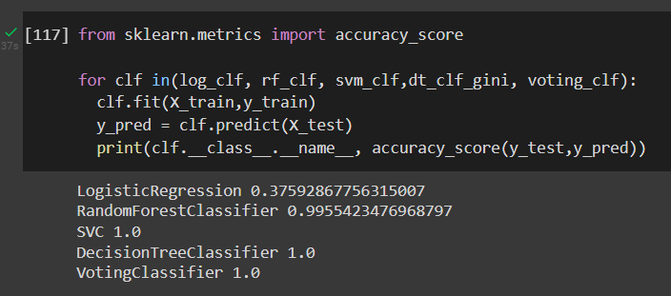
Results
Experiments with train, test, split size:
1) test size = 0.2
2) test size = 0.1

Slide 5
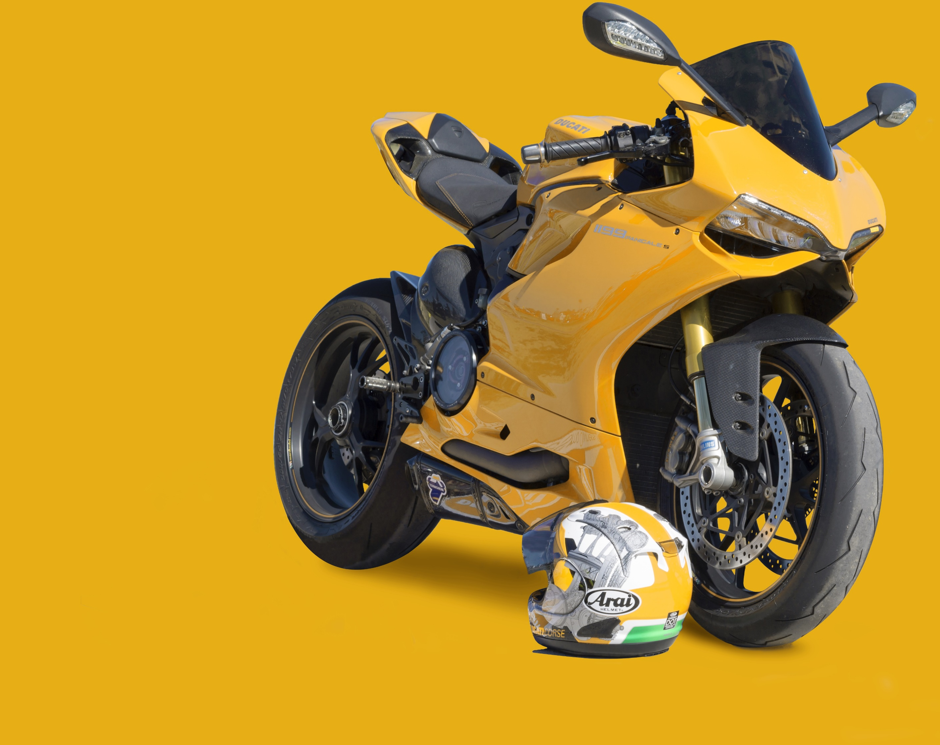
Questions?

